Slide 1
Attitudes towards the Church in Chile
A time series analysis of Latinobarometer survey
Sathiya Raju & Pedro Pablo Errázuriz
Ironhacks Data Analysis Bootcamp 2021

Slide 2
Trust in the Church in Chile
Source: Latinobarometer 1995-2018

Slide 3
Trust in the Church in Chile and other countries - comparisson
Source: Latinobarometer 1995-2018

Slide 4
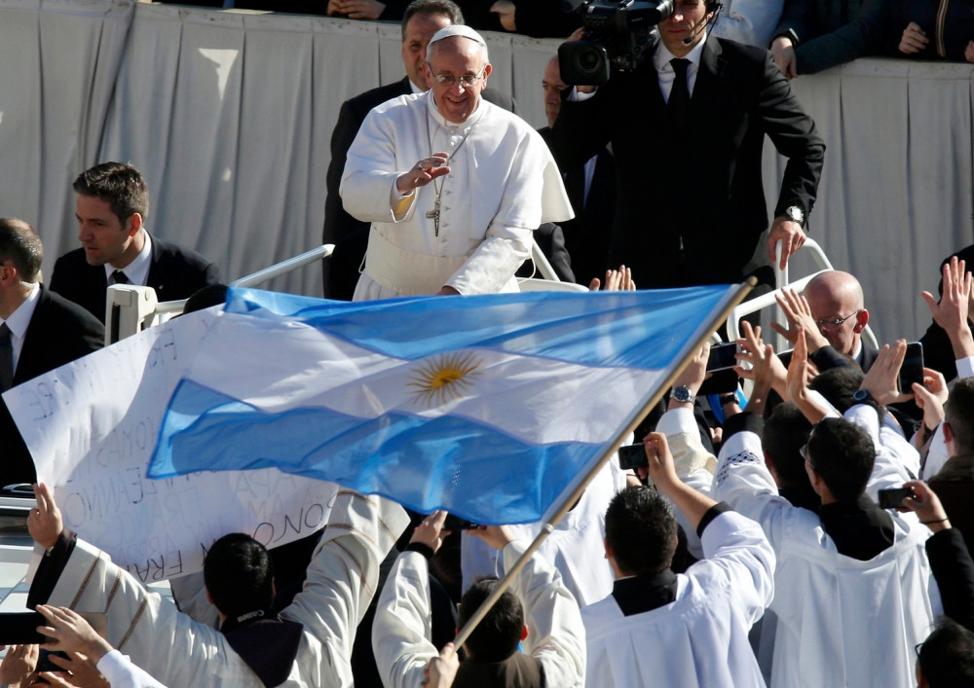
Trust in the Church in Chile and other countries - comparisson
Source: Latinobarometer 1995-2018

Slide 5
Trust in the Church in Chile and other countries - comparisson
Source: Latinobarometer 1995-2018

Slide 6
Trust in the Church in Chile and other countries - comparisson
Source: Latinobarometer 1995-2018

Slide 7
Trust in the Church in Chile and other countries - comparisson
Source: Latinobarometer 1995-2018

Slide 8
Trust in the Church in Chile disaggregated by gender
Source: Latinobarometer 1995-2018

Slide 9
Relative decrease in trust in the Church by cohort
Source: Latinobarometer 1995-2018

Slide 10
WHY?

Slide 11
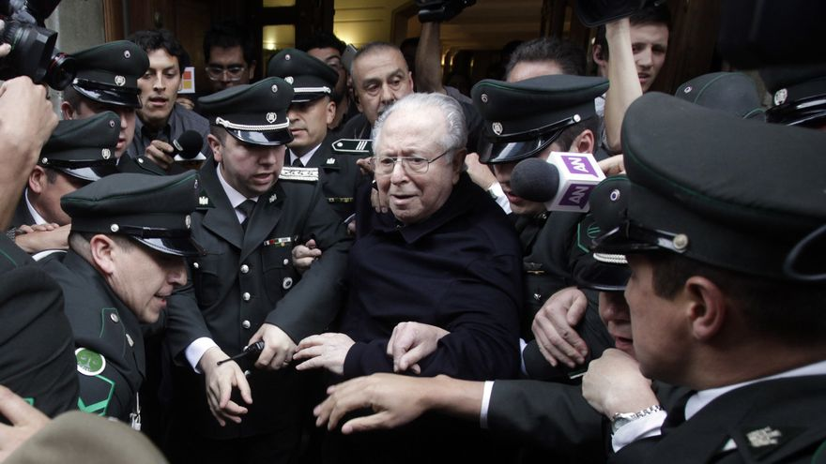

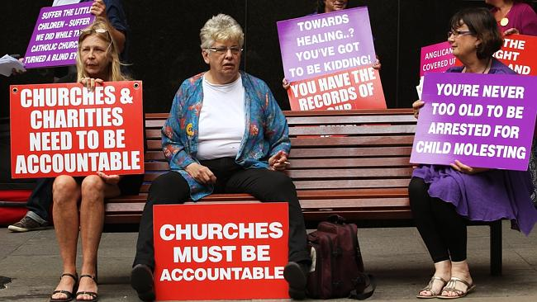
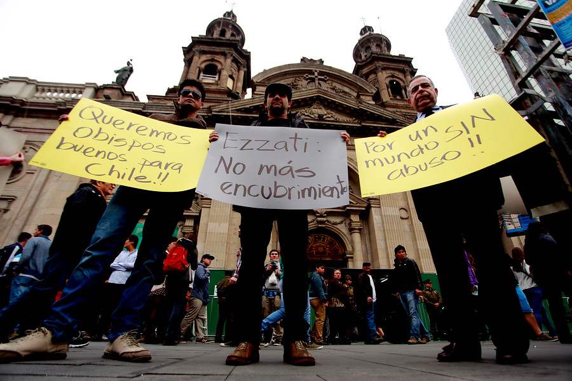
WHY?

Slide 12
ONG Red Sobrevivientes database – sexual abuse denounces by year
Source: ONG Red Sobrevivientes

Slide 13
ONG Red Sobrevivientes database – sexual abuse denounces by year
Source: ONG Red Sobrevivientes

Slide 14
Conclusions
It is posible to perceive a correlation between the trust in the Church and the emergence of sexual abuse denounces involving members of the Church.
Our analysis does not allow to quantify the effect of each denounce in particular.
Regardless, at the same time the Trust in the Church experienced a sharp decreased, denounces amounted, and social and institutional habits changed, encouraging victims to speak up and judicial processes move forward.
Interesting further analysis should include comparisson countries that have gone through similar processes, i.e. Ireland.

Slide 15
Thank you
Muchas gracias
Vielen Dank

